Slide 1
Wavelet™ & The FAI™ Platform
Cyber-Security Overview
November 2024

Slide 2
Agenda
IoT cyber security background & trends
Wavelet cyber security highlights
FAI Platform cyber security highlights
Common IoT cyber security mistakes & misconceptions
Certificates & processes
New security features in the FAI

Slide 3
Part 1:
IoT Cyber Security Background

Slide 4
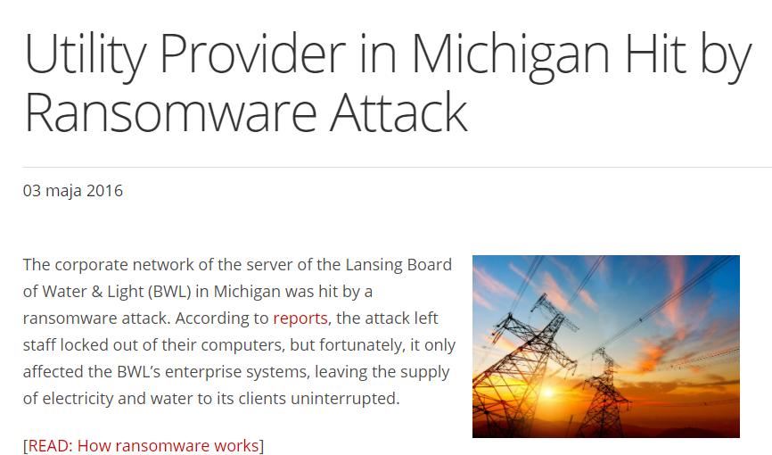

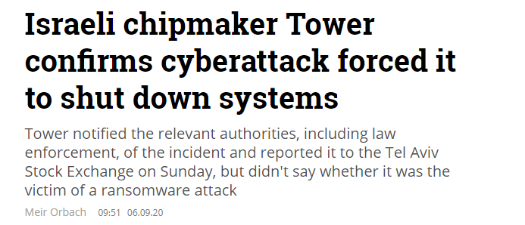
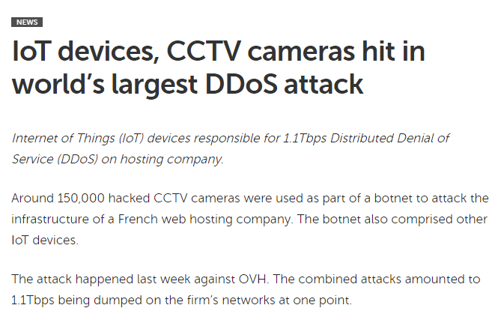

Cyber Attacks are Real

Slide 5
Understanding Cyber Attacks
How does it work?
The attacker finds a vulnerable asset
An attack is launched against the vulnerable asset
The attacker gains unauthorized access to its target and achieves the attack’s objectives
What are their objectives?
Denial of service
Ransom/blackmail
Data theft
Data manipulation
“Public relations”
Who is behind cyber attacks?
Govt. agencies
Organized crime groups
Terrorist groups
Hacktivists
“Generic” hackers

Slide 6







Industrial IoT Cyber Threats
IoT systems have many components that interact with each other
Sensors
Every component is a potential target for a cyber attack
Software Systems
Dataloggers / PLCs / RTUs
Every interaction between components is also a potential target
APIs
Mobile Apps

Slide 7


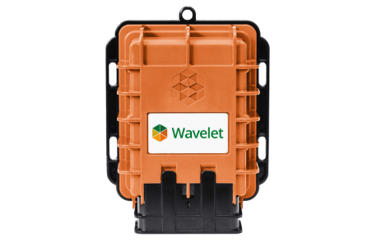
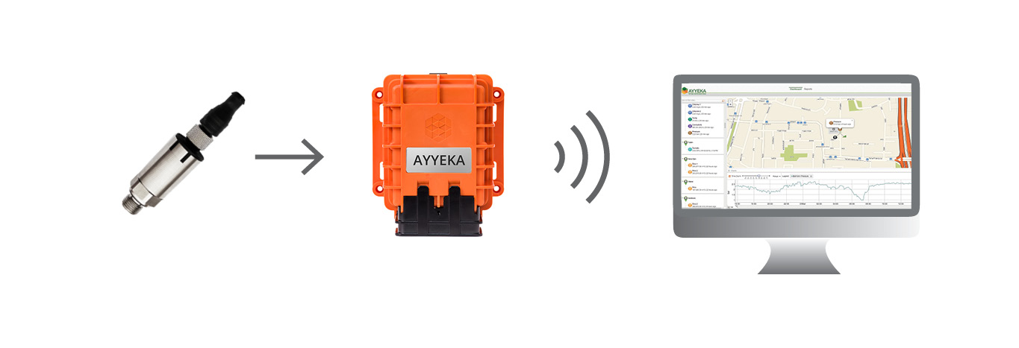




FAI Components and Interactions
3rd Party
Applications
{api}
FAI Platform
4-20mA
0-5V / 0-28V
Modbus RTU
(RS485/RS232)
SDI-12
Digital I/O
HTTPS / MQTTS
---------------------
2G/3G/4G
LORAWAN
NBIOT/CAT-M
REST API
DNP3
OPC UA
CSV Export
Notes:
An attack on the left side (sensors) is not so much a cyber-attack. It’s more like a physical attack.

Slide 8


Example #1: Network Attack on the Device
Intercept the communication between the platform and the device in order to corrupt the device configuration
Browser
{api}
Device
Software Platform
Programmatic Access

Slide 9
Example #2: Network Attack on the Server
Intercept the communication between the device and the platform in order to modify the data that arrives to the platform
Browser
{api}
Device
Software Platform
Programmatic Access

Slide 10
Example #3: Bluetooth Communication Attack
Compromise the Bluetooth communication channel in order to gain configuration access to the device
Browser
{api}
Device
Software Platform
Programmatic Access

Slide 11
Example #4: API level attack
Hijack an API session in order to gain programmatic access to a specific user account
Browser
{api}
Device
Software Platform
Programmatic Access

Slide 12




Mitigating IoT Cyber Threats
Design for
cyber-security
Identify potential threats in the design or implementation
Develop features, capabilities and guidelines to reduce the risk
Deploy updates to devices and servers
And repeat!
Notes:
Cyber security threats are changing all the time:
New vulnerabilities are found every day
A new software/firmware version may contain new bugs
The technology landscape is evolving fast

Slide 13




FAI Cybersecurity Pillars
Secured hardware
Secured software
Best Practices
Notes:
Hardware = Wavelet / Datalogger
Software = platform
Best practices = architecture, updates etc

Slide 14
Part 2:
Wavelet Cyber-Security Features

Slide 15






Wavelet Cyber Security Highlights
TLS v1.3 with 0-RTT for Extended Battery Life
Enhanced Bluetooth and Mobile App Security
Hardware-based Device Authentication
Dynamic IP Address & NAT Support
Over-the-air Firmware Upgrades
Secured Diagnostic Port

Slide 16
TLS v1.3 Support
Wavelet is using TLS* to secure its connection with the FAI platform
TLS v1.2 is now 13 years old and being replaced with TLS v1.3
TLS v1.3 has two main benefits for IoT devices:
  Stronger cryptographic and encryption methods compared with TLS v1.2
  0-RTT an optional TLS feature for increasing communication efficiency
* TLS = Transport Layer Security, the gold standard for securing TCP/IP
Notes:
TLS 1.3 portfolio of methods.
more and stronger efficient , less battery usage.
TLS, overhead on data.
TLS 1.3 zero round trip time resumption, → reuse old session

Slide 17
TLS v1.3 0-RTT for Extended Battery Life
TLS adds an overhead that is often larger than the data it protects
TLS v1.3 introduce the “0-RTT” feature that reduce this overhead:
  With 0-RTT, TLS sessions can be reused in a secured way
  Reusing TLS sessions eliminates most of the TLS overhead
0-RTT = Faster Transmission + Extended Battery Life
Notes:
Improved performance

Slide 18
Hardware-based Device Authentication
Trusting data begins with trusting the data source
To establish and maintain trust, the FAI platform authenticates the devices by using pre-shared hardware-based identifiers
How does it work?
  During manufacturing, secret hardware identifiers are captured for each device
  The identifiers are securely hashed and stored on the FAI platform
  For authentication, the device presents one or more secret identifier(s)
What if a secret identifier is compromised?
  Stop using it and use another one instead
Notes:
hardware identifiers, finger prints

Slide 19
Over-the-air Firmware Upgrades
Security vulnerabilities in the IoT space are discovered very often
Selected examples for vulnerabilities in 3rd party code:
  AMNESIA:33 – affects millions of devices from over 150 different vendors
  NAME:WRECK – affects over 100M devices from wide range of vendors
When a vulnerability is discovered, a virtual race begins:
  Attackers race to exploit the vulnerability before it’s gone
  IT/OT staff race to patch vulnerable devices before they get hacked
OVER-THE-AIR UPGRADES IS THE ONLY WAY TO QUICKLY PATCH FIELD DEVICES AGAINST CYBER THREATS

Slide 20
Enhanced Bluetooth and Mobile App Security
Wavelet and the AyyekaGo™ mobile app interact over Bluetooth
The Bluetooth standard is infamous for its broken security
Solution: a three-pronged approach to eliminate Bluetooth risks:
  Wavelet and AyyekaGo apply strong encryption on top of Bluetooth
  Unique device access code for strong mobile-app user authentication
  Wavelet’s Bluetooth signal is automatically turned off when idle in order to avoid detection by scanners. Physical access is required in order to temporarily switch the signal on.
Notes:
Encrypt
Pairing-key
“Reduce the attacking surface”, 15 minutes

Slide 21
Dynamic IP Address & NAT Support
Open ports on field devices are hard to secure and invite trouble
Wavelet and the FAI platform are design to avoid this risk:
  Wavelet does not listen on any port for incoming connections
  Wavelet does not require a fixed IP nor a dynamic DNS service
  Wavelet can reside behind a NAT, as long it can reach the FAI platform
With this architecture, the burden of protecting open ports shifts to the FAI platform, where state-of-the-art network security tools can be deployed
Notes:
The Wavelet is off-line, u can not remotely.
Not listening to incoming traffic
The Wavelet initiates the communication to the platform
The port are only open when the Wavelet wakes up.
We are shifting the support of protecting the ports to the platform, away from the Wavelet
NAT.

Slide 22
Secured Diagnostic Port
Wavelet is equipped with a USB interface for diagnostics purposes
The USB port is concealed under the device’s back cover plate
Sensitive operations are not supported over the USB interface
In particular, the following operations are NOT available over USB:
  Firmware modification, upload, and download
  Access or modification of stored data
  Ability to upload any data to the server via the device
Notes:
Data is not available, via USB.
USB → username & password

Slide 23
Part 3:
FAI Platform Cyber Security Features

Slide 24




FAI Platform Cyber Security Highlights
High availability and scalable architecture
Network traffic inspection
Secured API access
Data encryption, at rest and in transit
Monitoring and Incident response team

Slide 25
High Availability and Scalable Architecture
Hosted on Amazon Web Services (AWS)
Incoming traffic is processed by a CDN and set of load balancers
Servers are deployed to multiple availability zones for redundancy
Resources are added on the spot in response to demand increase
All incoming data is backed up on offline storage (S3)
Notes:
Content Delivery Network → when traffic hits, first Amazon traffic
4 to 8 application servers , to respond to demand

Slide 26
Network Traffic Inspection
The FAI platform is processing traffic from three major sources:
  Field devices
  Users’ browser requests
  API calls
The traffic is filtered by a firewall , IPS and a WAF to prevent:
  Access to sensitive IPs and ports
  Traffic from IPs with bad reputation
  Attempts to use known vulnerabilities
  SYN floods and other DoS attempts
Notes:
Firewall, intrusion preventive system

Slide 27
Secured API Access
The FAI platform offers a rich REST API that provides access to popular platform features in a programmatic way
  API access is enabled when a user creates an API access key pair
  API access can be revoked by the user any time
API Usage:
  To gain access, the API caller first needs to present a valid API key pair
  Once authenticated by the platform a short-lived token (JWT) is return to the caller. This token needs to be presented with every API call
  Rate limiting is applied in order to prevent API abuse
All API calls are logged and monitored
Notes:
JSON Web Token (JWT) access tokens conform to the JWT standard and contain information about an entity in the form of claims.

Slide 28
Data Encryption
Data is encrypted both in transit and at rest
Encryption of data in transit is done using TLS:
  Device data (HTTPS / MQTTS)
  REST API calls (HTTPS)
  User interface browser requests (HTTPS)
Data at rest is secured with Amazon’s MySQL RDS encryption:
  The database is encrypted using AES-256
  All snapshots and backups of the database are encrypted as well

Slide 29
Monitoring and Incident Response Team
The FAI platform is monitored 24/7 by a dedicated NOC team
Myriad of system metrics and logs are analyzed to ensure the availability, performance, and security of the platform
Any performance degradation is detected and handled on the spot
Unusual traffic patterns and system loads are reported immediately to the on-call security response team

Slide 30
Part 4:
Common IoT CyberSecurity Mistakes & Misconceptions
WARNING!
OVERLOADED SLIDES AHEAD!

Slide 31
“We have a private APN and it keeps us safe”
Q: What is a “Private APN”?
A: A “Private APN” is the cellular providers’ way to assign specific cellular devices to a certain IP network (subnet)
Q: Is it like a VPN?
A: Unlike VPNs, a private APN, does not add an extra layer of encryption to your data nor does it add strong authentication. It is simply a way to assign a device to an IP range on the cellular provider network, based on the SIM card ID and/or username&password
Q: Is it really a private network? How can I confirm that?
A: Private APNs are set up and maintained by the cellular providers. In 99% of the cases, the end-user (the SIM owner), does not have any administrative access to manage the APN, nor does it have any monitoring access that allows him to know what exactly is going on there

Slide 32
“We have a private APN and it keeps us safe”
Q: What if someone obtains one of my SIM cards?
A: In most cases, obtaining a single SIM card (e.g. from an old field device) and the APN name is all an attacker needs in order to gain access to the “private network”
Q: My APN requires a username and password, isn’t it good enough?
A: APN username and passwords are good only if they are unique, strong and frequently changed. In reality, devices are typically assigned the same username and password (often empty password!) and passwords are never rotated → huge risk
Q: Why use private APNs at all?
A: Many legacy IoT devices do not support strong authentication, let alone TLS. In this scenario, a private APN is the only way to somewhat isolate these vulnerable devices from the rest of the world. Modern IoT solutions, like Wavelet and the FAI platform, make use of TLS, strong authentication and a “Zero Trust” architecture in order to achieve state of the art cyber security. Therefore, a private APN does not bring any significant benefits to modern IoT solutions.
Notes:
Private APN doesn’t have end2end encryption.

Slide 33
Relying on Fixed IPs
Legacy IoT devices often require a fixed IP address due to legacy architecture in which the server reaches out to the device
There are several downsides for using fixed IP addresses
  Logistics: it takes time to set up and assign unique IP per device/SIM
  Risk: Fixed IP address usually means open ports → The devices are sitting ducks for cyber attacks (even if not using public IPs)
  Cost: cellular operators tend to charge more for managing fixed IP address ranges, even if it’s just internal Ips
Best practice:
Do not open any ports on the device → no need for fixed IP addresses..

Slide 34
Weak Device Authentication
No matter which software platform is used, when field data is received, it is always identified by the source device that produced it
Legacy field devices often leave the end-user to assign devices’ their identity, which typically results in choosing weak identifiers. E.g.:
  “1”, “2”, “3”
  “site1”, “site2”, “site3”
Using weak identifiers is prone to malicious data injection
It therefore imperative to use strong (e.g. hardware-based) identifiers

Slide 35





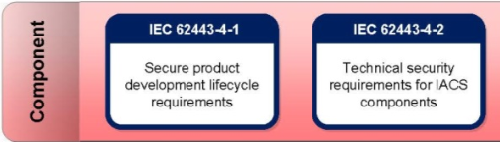
Certificates & processes
* Ayyeka has some of the above is working on the rest.

Slide 36
New security features in the FAI
Automatic log out from the UI.
Decide when to reset user passwords
2FA
Security logging
Mutual TLS
Threat modeling
Notes:
Threat modeling is a family of activities for improving security by identifying threats, and then defining countermeasures to prevent, or mitigate the effects of, threats to the system.

Slide 37
Thank you
For more details – info@ayyeka.com

